Slide 1
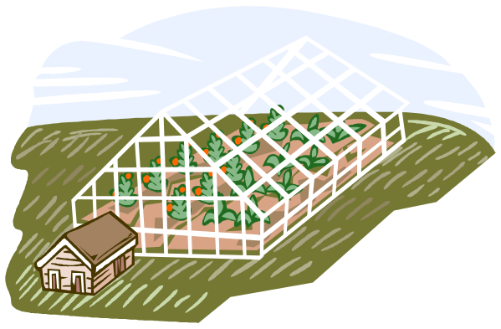
Indoor Oasis
Quarterly Report

Slide 2
Progress
ShopScape Project
  On track for November promotion
Floral Functions
  Spring Carnival Success
New Plant Range
  Health Endorsement
  Report from Senior Horticulturalist

Slide 3



Attention Areas
Beetle Infestation (Rhaetus westwoodii)
  Opportunity to promote IO_BioSolv patented control programs
Impending Election
  Demand for hire has increased due to election – need to establish achievable targets

Slide 4
Planned Activities
Election Functions
ShopScape Promotion
Floral Functions Review
  Lessons learned from Spring Carnival
  Species review
WinterFest Range

Slide 5
Deliveries
Review of upcoming functions
Key Clients
Maintenance Programm review
New Quotation System

Slide 6
Costs
Marketing Budget
  original Estimate $1.2 million
    Projected according to previous growth patterns
  currently $1.4 million
    Promotions to the election function market
Planter Cost Overruns
  increase in steel planters due to price of raw materials
  investigating cheaper alloys or plastic bases
  expect to control this through material substitution, or application of premium

Slide 7
Marketing Costs

Slide 8
Production Update
Watering system issues resolved
Source of sphagnum moss threatened
  Increased humidity at source caused outbreak of Cutaneous sporotrichosis

